Slide 1
CODING SAMURAI INTERSHIP PROJECTS
BY AKANDE USMAN BATCH A-43
PROJECT TRACK- BUSINESS ANALYTICS

Slide 2
PROJECT 1
ONLINE STORE DASHBOARD
BUSINESS QUESTIONS/OBJECTIVES
CALCULATE BASIC SALES METRICS LIKE TOTAL REVENUE
VISUALIZE TRENDS USING BASIC LINE AND BAR CHARTS
IDENTIFY THE TOP 3 PRODUCTS BY SALES AND

Slide 3
TOTAL REVENUE GENERATED =$ 80 576

Slide 4
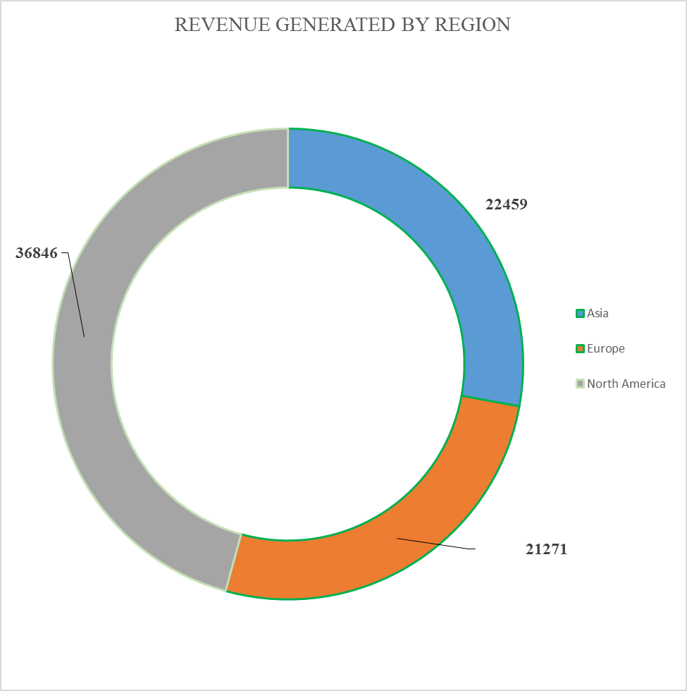
THE REGION WITH HIGHEST REVENUE GENERATION IS NORTH AMERICA
THE REGION WITH LOWEST REVENUE GENERATION IS EUROPE

Slide 5
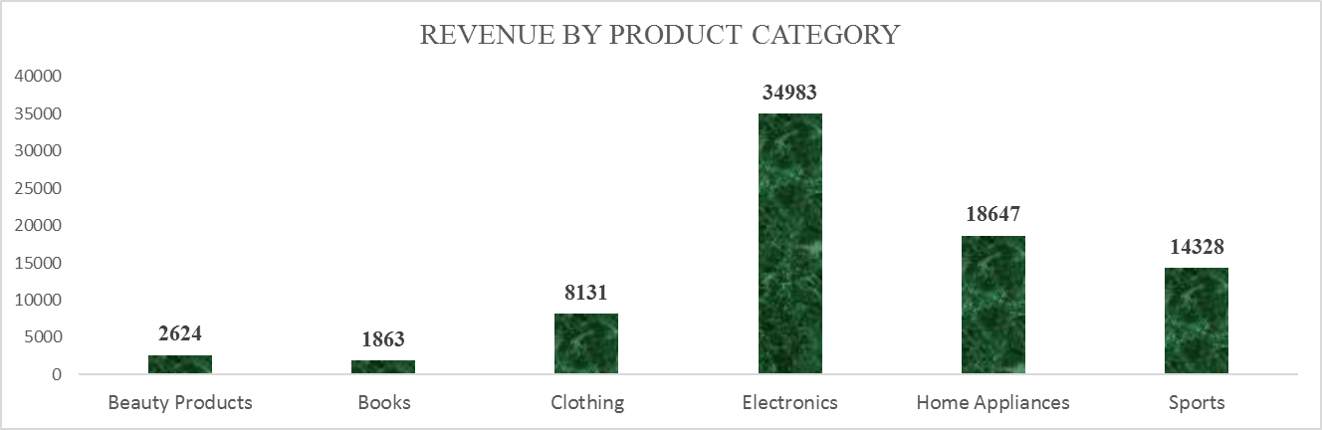
THE CHART ABOVE SHOWS THAT ELECTRONICS IS THE BEST PRODUCT THAT GENERATED HIGHEST REVENUE WHILE BOOKS GENERATED THE LOWEST REVENUE

Slide 6
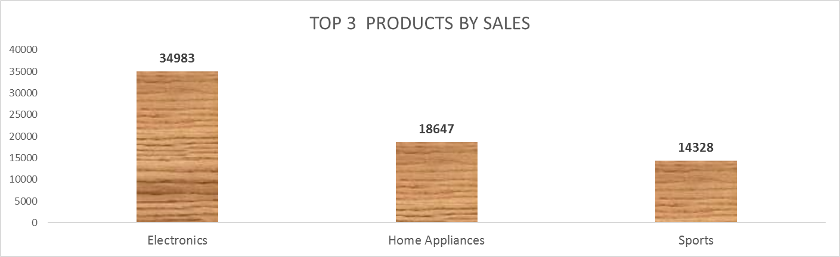
THE CHART ABOVE SHOWS THE BEST 3 SELLING PRODUCTS IN THE COMPANY

Slide 7
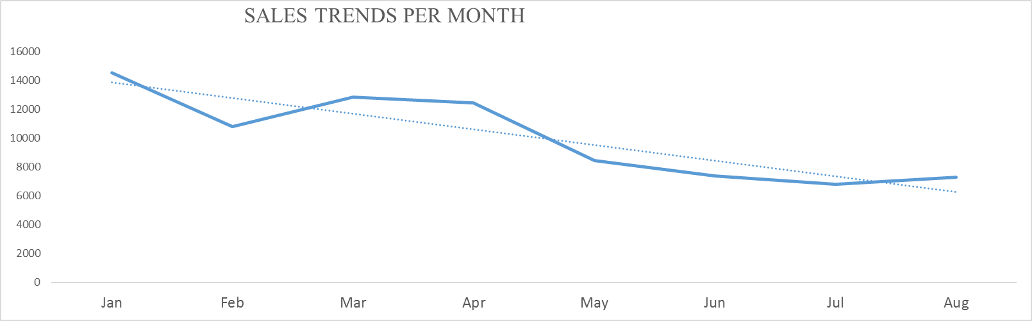
THE SALES TRENDS INDICATE THAT THE PEAK SALES OCCUR IN JANUARY WHILE THE LOWEST SALES IS IN JULY

Slide 8
RESULTS AND FINDINGS
THE ANALYSIS RESULTS ARE SUMMARIZED AS FOLLOWS:
THE TOTAL REVENUE IS $ 80 576
THE TOP 3 SELLING PRODUCTS ARE ELECTRONICS, HOME APPLIANCES AND SPORT
THE BEST MONTH WHERE THERE IS PEAK SALES IS JANURAY WHILE JULY IS WHERE THERE WAS NO MUCH SALES

Slide 9
RECOMMENDATION
BASED ON THE ANALYSIS, I RECOMMEND THE FOLLOWING ACTIONS:
INVEST IN MARKETING AND PROMOTIONAL CAMPAIGNS DURING PEAK SALES SEASON TO MAXIMIZE REVENUE
FOCUS ON EXPANDING AND PROMOTING THE TOP THREE PRODUCTS I.E ELECTRONICS, HOME APPLAINCES AND SPORT
PRODUCTS SHOULD BE CHANNELLED MORE TO NORTH AMERICA AS IT IS THE REGION WITH HIGEST SALES WHILE EFFORTS SHOULD BE MADE IN CREATING AWARENESS TO OTHER REGION TO ENABLE MORE SALES

